Slide 1
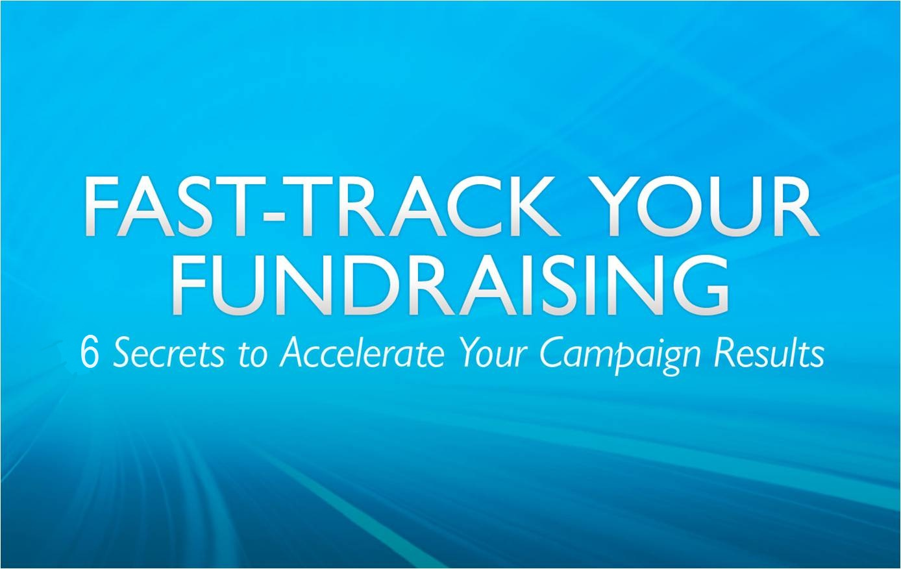
Notes:
This is fast-track your fundraising.

Slide 2
Who Are We?

Slide 3
Forward-looking statements
This presentation contains forward-looking statements intended to convey expectations as to the future based on plans, estimates and projections. All statements other than statements of historical fact could be deemed forward-looking, including, but not limited to, any projections of financial information; any statements about historical results that may suggest trends for our business; any statements of the plans, strategies, and objectives of management for future operations; any statements of expectation or belief regarding future events, potential markets or market size, technology developments, or enforceability of our intellectual property rights; and any statements of assumptions underlying any of the items mentioned. Although Convio believes that the expectations reflected in such forward-looking statements are reasonable, future circumstances might differ from the assumptions on which such statements are based. In addition, these statements can be affected by inaccurate assumptions and a variety of risks and uncertainties that could cause actual results to differ materially from those described in this press release including, among others: unfavorable economic and business conditions, in particular with respect to nonprofit market in which we operate; our ability to attract new customers; the loss of significant customers or a substantial reduction in orders from the existing customers; the inability of customers to pay for our solutions and services; our continued success in sales growth; our ability to develop new or enhanced solutions to meet the needs of our clients; technological changes that make our products and services less competitive; risks associated with successful implementation of multiple integrated software products; the ability to attract and retain key personnel; risks associated with management of growth; lengthy sales and implementation cycles; intellectual property infringement claims and other litigation; reliance on certain third-parties, including hosting facilities, software and application providers; the ability to access sufficient funding to finance desired growth and operations; legislative actions which could reduce the effectiveness of our solutions and increase the costs of our business. These factors and other risks and uncertainties are described in more detail, in the prospectus for our proposed initial public offering. Should one or more of these risks materialize, or should underlying assumptions prove incorrect, actual results may vary materially from those expressed or implied in any forward-looking statements. The forward-looking statements are made as of the date hereof and Convio does not undertake to update or revise any of these statements as a result of new information, future events or otherwise.
Notes:
“As you might be aware Convio has recently become a publicly traded company. During the period after our initial public offering and like other public companies you work with, I need to share with you required information about the forward-looking statements in our presentation. If you have any questions, please let me know and I am happy have someone from our finance or investor communications team contact you.”
Let the audience read for a few more seconds then move on with excitement about the topic of the presentation.

Slide 4
2 Quick Questions
Notes:
1. Please estimate the number of fund development staff you have within your organization.
2. Please estimate the number of email addresses your organization has collected.

Slide 5
Building Your Email List is
Donor Prospecting
1
Secret #
Cumulative Online Revenue
# Email Records
Notes:
This organization started with us in 2006, with less than 300 email addresses on their file

Slide 6
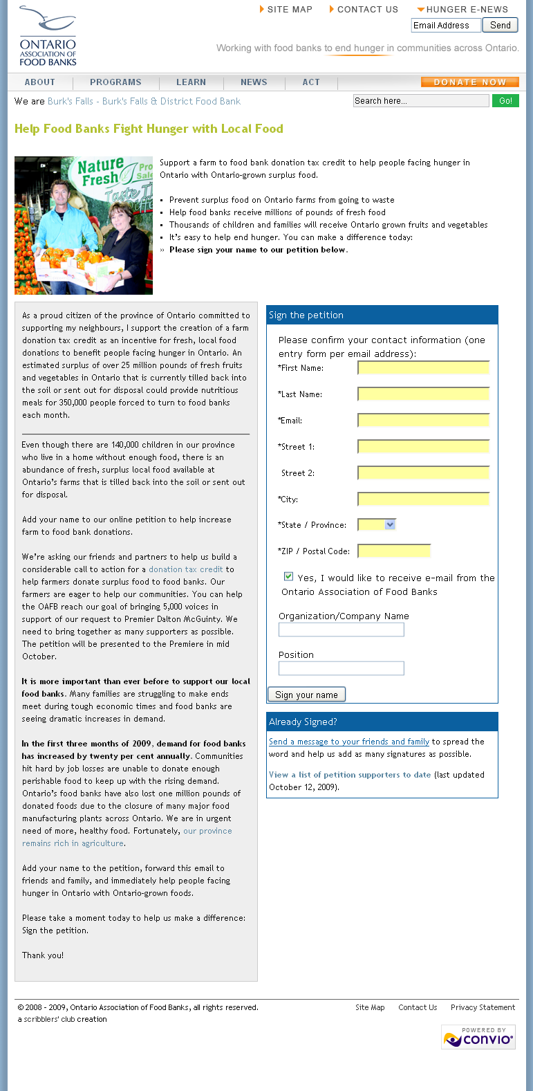
List Growth
Joined Go! April 2009
Fielded petition
Doubled their list
Boosted revenue 600%
Notes:
In addition, OAFB raised over $200K online in their first nine months with Convio – already 685% growth over the previous year.

Slide 7
| by the numbers
Secret # 1
399
  Average new emails gathered
  via list growth campaign
Notes:
Organizations can expect
$11 in online revenue
for every email subscriber recruited

Slide 8
| by the numbers
Secret # 1
$11
  Average annual online revenue per email address
Notes:
Organizations can expect
$11 in online revenue
for every email subscriber recruited

Slide 9
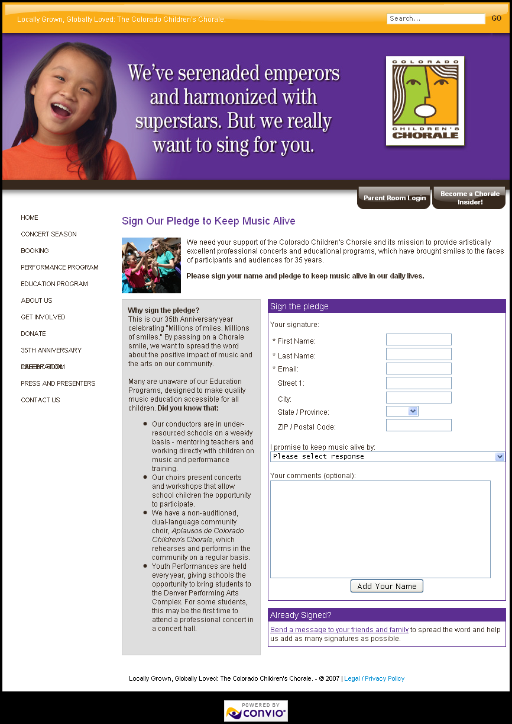

List Growth Ideas
Pledges

Slide 10
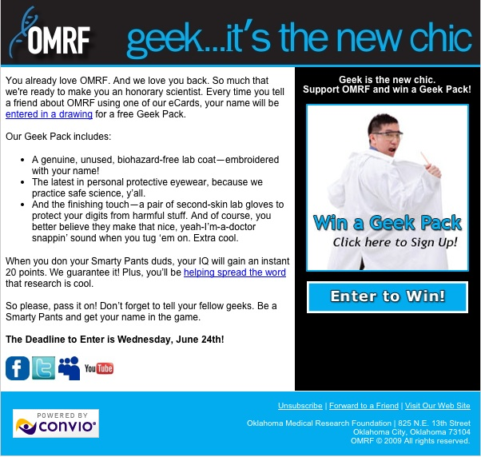

List Growth Ideas
Pledges
Give-Aways

Slide 11
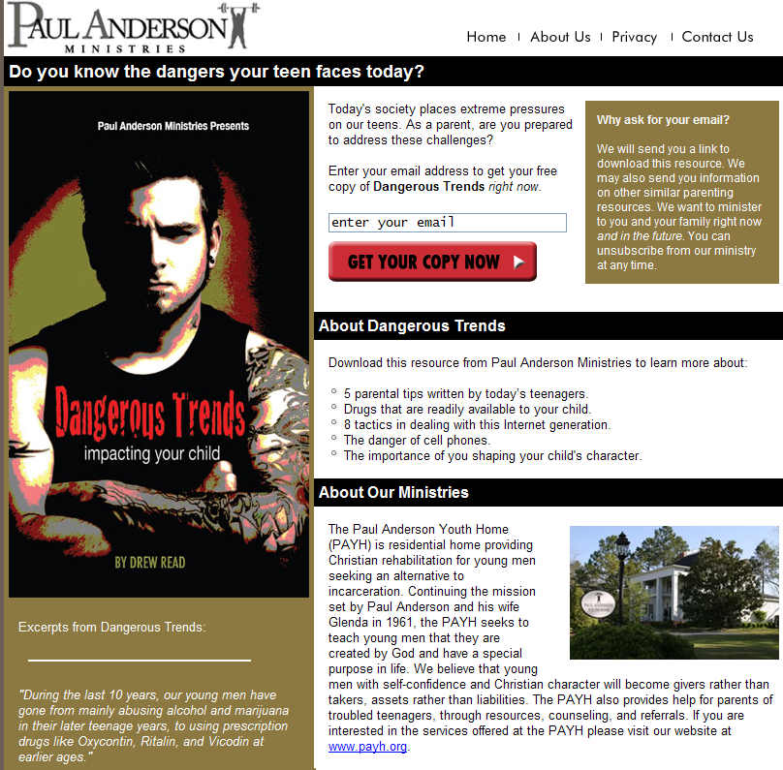
List Growth Ideas
Pledges
Give-Aways
Downloads

Slide 12

List Growth Ideas
Pledges
Give-Aways
Downloads
Sponsored Donations

Slide 13
| by the numbers
GO! Program
>60%
  Email list growth in the Go! Program
Notes:
Organizations can expect
$11 in online revenue
for every email subscriber recruited

Slide 14
Stump the Speakers
Want a list growth idea? Drop in a card.
5 orgs get list growth campaign ideas
THIS MORNING
If you stump us, you win a free 1:1 consultation

Slide 15
When it comes to subscribers,
Use Them Or Lose Them
2
Secret #

Slide 16
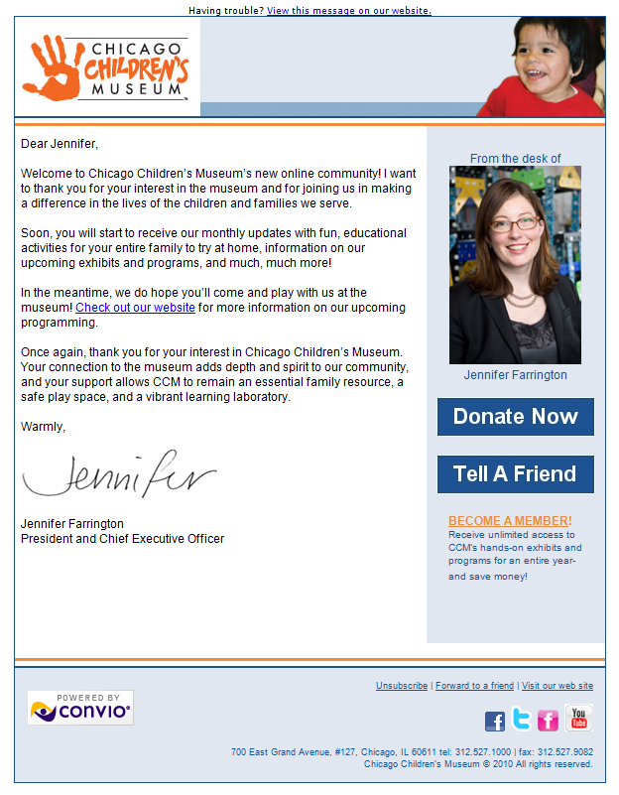
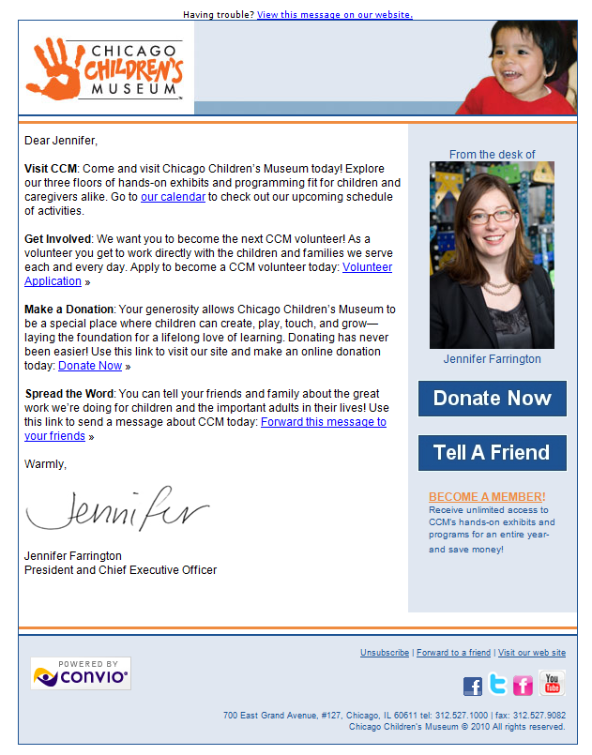
Automated Welcome Series

Slide 17
| by the numbers
Secret # 2
50%
  Increased likelihood of
  message open, first month
Notes:
Organizations can expect
$11 in online revenue
for every email subscriber recruited

Slide 18
| by the numbers
Secret # 2
3%
  Average click-through rate in early messages
Notes:
Organizations can expect
$11 in online revenue
for every email subscriber recruited

Slide 19


What Comes After the Welcome?
GETTING STARTED
SPRING FUNDRAISING CAMPAIGN
HOUSEFILE BUILDING
CAMPAIGN
YEAR-END FUNDRAISING
CAMPAIGN
Converting site visitors
Welcoming new subscribers
Welcome series launch
eNewsletter production
Writing a compelling ask
Cultivating new supporters
Donation form build & test
Build & send email appeals
Continue eNewsletters
Outreach tactics
Viral marketing
eCards & rewards programs
Build/send outreach series
Continue eNewsletters
Maximizing year-end giving
Best-practice donation forms
Donation form build & test
Build & send email appeals
Continue eNewsletters
Q1
Q2
Q3
Q4
What Go! Program participants accomplish in 12 months…
Notes:
Program calendar for clients who sign any time in Q4

Slide 20
Convio Online Fundraising Software
A Proven Action Plan (inc. Production)
Capacity-Building Consulting
+
+
=
Tangible Results Today & Know-How For Tomorrow
Notes:
You do NOT have to
Conduct research, follow trends, build consensus, cobble together tools, struggle to learn tools, neglect strategy, neglect supporters, get burned-out!

Slide 21

When it comes to Cultivation,
Content is King
3
Secret #

Slide 22
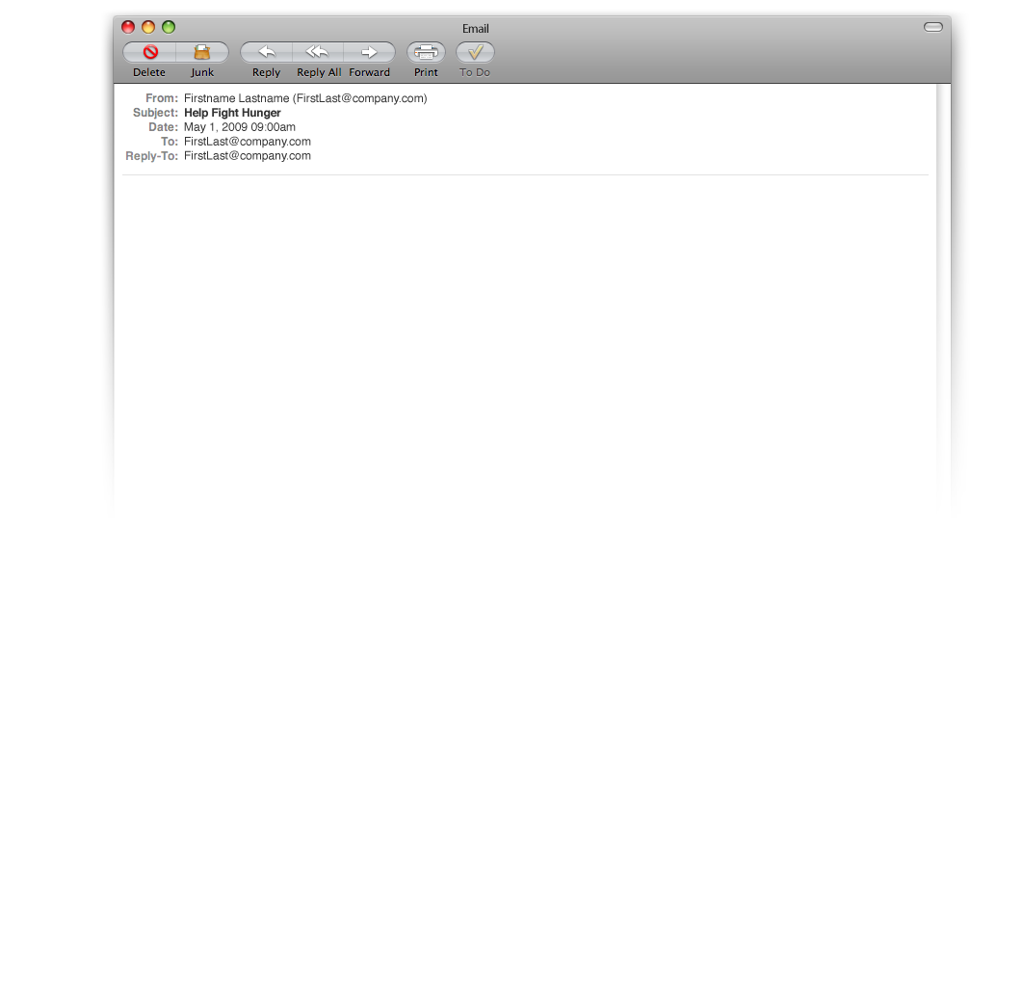

Get Your Clicks
Guess what topic
gets the most clicks?
    The recipes!
#1 objective is list growth
  30% yr/yr revenue growth
  Confident in eventual conversion of subscribers to customers…you should be, too!
Notes:
John Mast, VP Marketing for Expedia Cruise Ship Centers

Slide 23
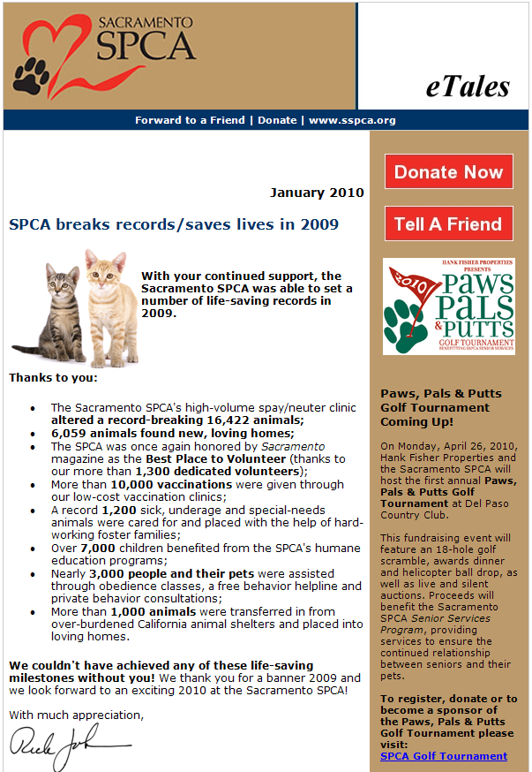
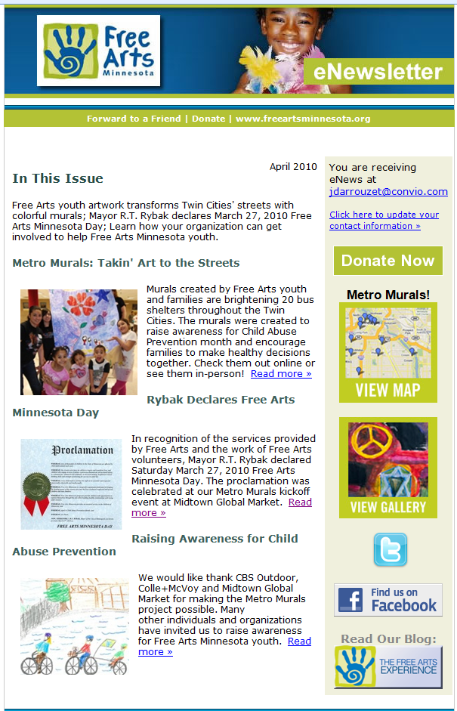
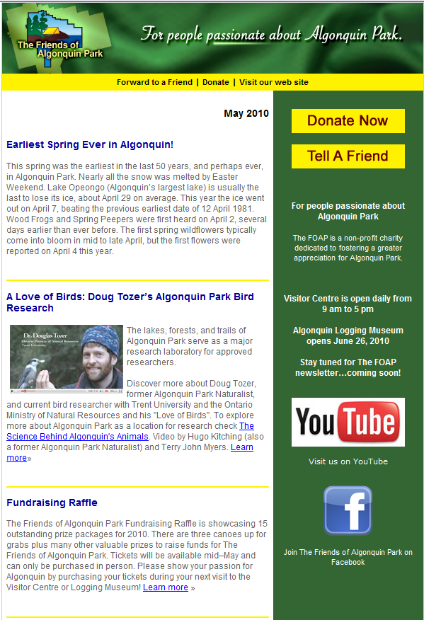

Deliver Distinctive, Compelling Content

Slide 24
| by the numbers
Secret # 3
19%
  Percent typically opening regular eNewsletters

Slide 25
| by the numbers
Secret # 3
>80%
  Percent of marketers who agree that social media extends the reach of email content to new markets
Notes:
MarketingSherpa’s Email Marketing Benchmark Survey, Aug 2009

Slide 26

| by the numbers
Secret # 6
50% | 25%
  Percent of Facebook posts | Tweets containing links
  Supporters can’t share content you don’t publish and broadcast online

Slide 27


Earn over 30 hours toward your CFRE

Slide 28
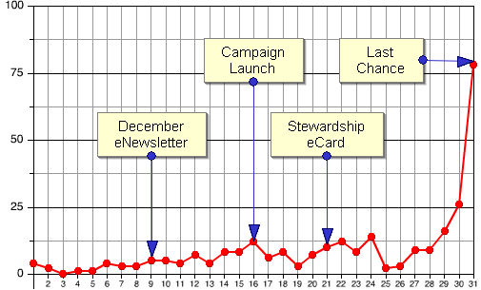
Online Fundraising is
Short-Attention-Span Theater
4
Secret #
Notes:
This organization started with us in 2006, with less than 300 email addresses on their file

Slide 29
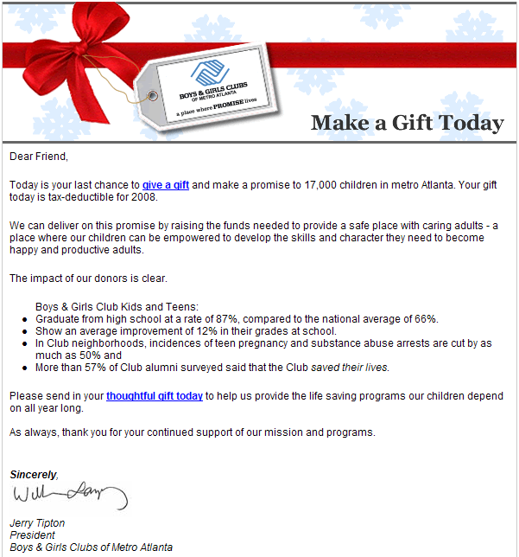
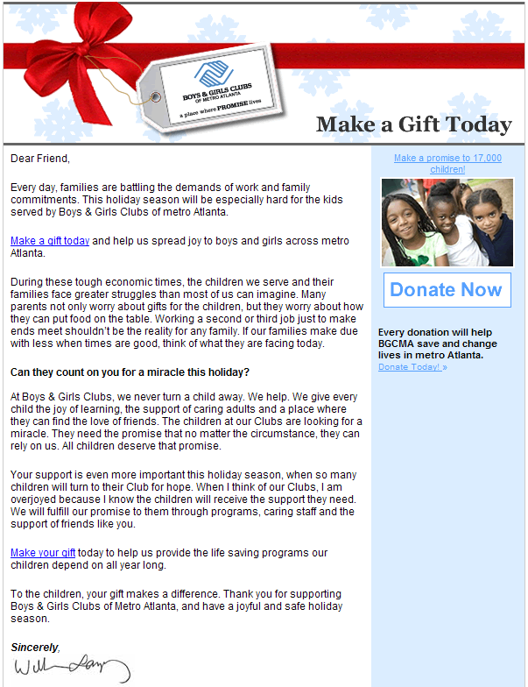
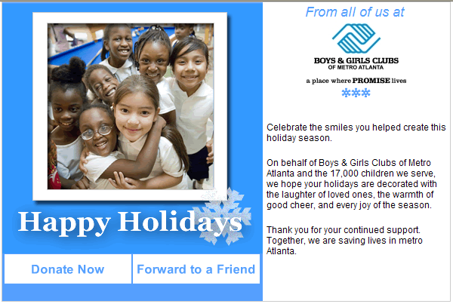
Multi-Part Campaigns
3
1
2

Slide 30
| by the numbers
Secret # 4
4X
  The amount of funds raised via multi-part email series
Notes:
Organizations can expect
$11 in online revenue
for every email subscriber recruited

Slide 31
| by the numbers
Secret # 4
$0
  Unlike Direct Mail, email has no per-piece mailing cost
Notes:
Organizations can expect
$11 in online revenue
for every email subscriber recruited

Slide 32
Online fundraising
| by the numbers
Online Donations processed by Convio
$921M
$1B YTD
$778M
$353M

Slide 33
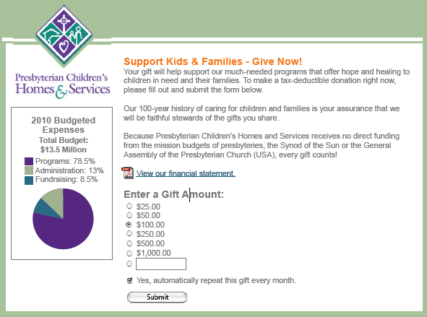
Sustainer Campaigning can be
Major Donor Prospecting
5
Secret #

Slide 34
| by the numbers
Secret # 5
$43
  Dollars the average donor committed monthly
Notes:
Organizations can expect
$11 in online revenue
for every email subscriber recruited

Slide 35
| by the numbers
Secret # 5
$516
  Average annual value of that donor
Notes:
Organizations can expect
$11 in online revenue
for every email subscriber recruited

Slide 36
| by the numbers
GO! Program
>$3
  Raised on average for every $1 invested in Go!
Notes:
Organizations can expect
$11 in online revenue
for every email subscriber recruited

Slide 37
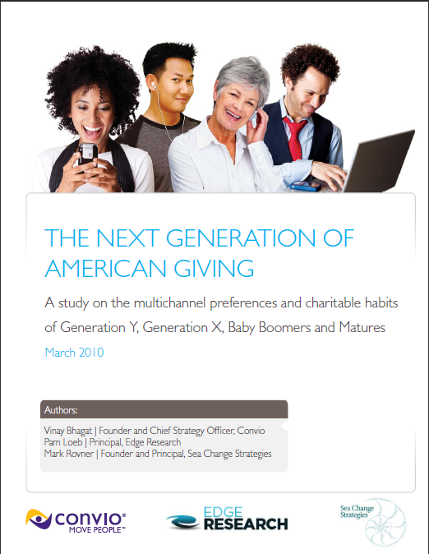
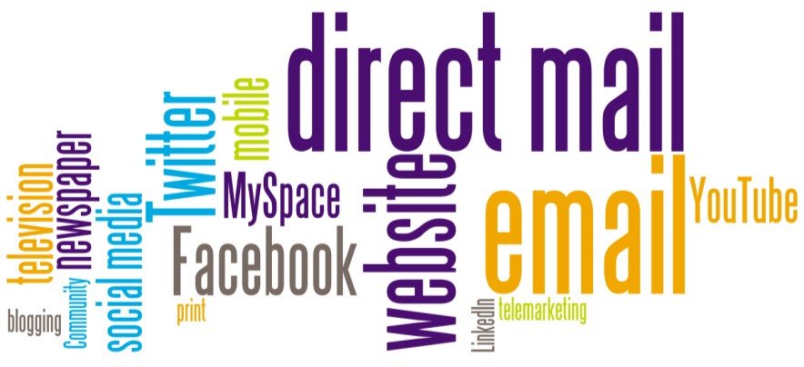
The Future of Fundraising is
Profoundly Multi-Channel
6
Secret #

Slide 38
Generational Giving Study
b. ≤1945
79% Give
30.8M donors
$1066 yr/avg
6.3 charities
$32.7 B/yr
Size of each pie is significant – represents total population of each
b. 1946-1964
67% Give
52.2M donors
$901 yr/avg
5.2 charities
$47.1 B/yr
Total Annual Giving
b. 1965-1980
58% Give
35.9M donors
$796 yr/avg
4.2 charities
$28.6 B/yr
b. 1981-1991
56% Give
28.5M donors
$341 yr/avg
3.6 charities
$9.7B/yr
% Giving
Notes:
Generational Giving
(64% of US adults qualified
About 148 million donors)
Pie Chart size represents size of ADULT population for that Generation
(Animated- Matures First)
Matures have the highest percentage of donors. Highest yearly average donation, and, the highest aggregate projected donation. But, they are our smallest population and have one of the smallest actual number of donors by Generation . Plus, by virtue of their age, their lifetime potential is dwindling.
Boomers average yearly donation is smaller than matures, but have a high percentage of donors, and given their population size, actually generate more in dollars than any other generation.
Our Gen Xers, the next largest population actually generate more than Matures, due to donor population size. Their average annual contribution is lower vs. older groups, but still impressive. Plus, their lifetime potential is much greater.
Gen Y is more about future potential, with over half currently donating, posting annual contributions averaging about $340, generating over $28 B a year.
Another trend we see is that younger generations give give to fewer charities, but when they give, they give similar amounts as older donors
Spend a lot of time focused and soliciting these groups (point to Matures), But the vast majority of the donor universe are Boomers, Gen Y and X – represent huge opportunity in terms of sheer numbers, and will only get more valuable (from a dollar perspective) over time
Hence as a fundraiser, if you have the ability to attract them, they can be economic in current terms, and of course constitute higher potential life time value, plus contribute to outreach due to their social networks/ peer influence.
Hence as a fundraiser, if you have the ability to attract them, they can be economic in current terms, and of course constitute higher potential life time value, plus contribute to outreach due to their social networks/ peer influence.
Question wording:
Q4. Approximately how many nonprofit organizations and charitable causes have you donated to in the past 12 months?
Q6. Approximately how much do you give in total each year to all charitable or cause-oriented organizations, excluding your school and place of worship? Blue numbering in the table on the right indicates significance at the 95% confidence level

Slide 39
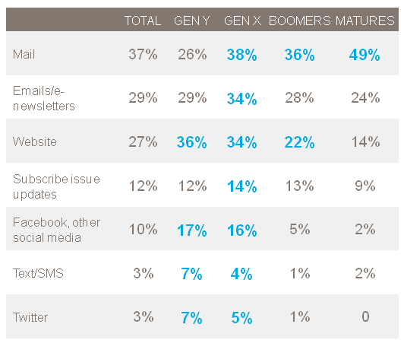
Secret # 6
| by the numbers
Channels for Communications

Slide 40
Secret # 6
| by the numbers
Channels for Giving
Gen Y | Gen X | Boomers | Matures
48% | 57% | 52% | 48%
26% | 43% | 54% | 77%
28% | 35% | 32% | 30%
29% | 35% | 31% | 25%
22% | 28% | 28% | 31%
22% | 22% | 27% | 35%
25% | 27% | 17% | 12%
8% | 10% | 16% | 25%
11% | 17% | 14% | 11%
14% | 13% | 4% | 2%
9% | 6% | 4% | 2%
Notes:
Lot of information on this chart.
Two most common ways to “give back” are what I know some of you refer to as “tipping” – leaving a buck for charity here or there at the supermarket, etc; and of course check by mail. But what I really want to focus on is some of the generational differences.
Gen Y most likely to give in small ways -- $1 at checkout type of gift. No one prevalent channel beyond that -- as likely to give via website as check, same numbers at gift shop, event, etc. More than 1-in-10 say they have participated in mobile philanthropy. Giving thru SM more prevalent than other generations, but still small.
Gen X true multi-channel givers -- more likely to give through many of these channels than other generations. Most likely to make online donations (though still a little less than good old check). Both X and Y more likely to participate in something like Gap Red campaign where part of the proceeds fr third party vendor purchase goes to charity. In focus groups we heard that this is a way that they can easily and affordably be charitable. Win-win (i.e. Gap – “I shop there anyway, and it’s a way to feel good”).
X using monthly debit more than other cohorts. –NOT REALLY -- THE DIFFERENCE IS WITHIN THE MOE
Matures (and Boomers) most likely to mail in a check. A third of Matures have made tribute gifts. More have given via phone solicitation than other generations (though still just a quarter).
Q7: Which of the following giving methods have you used in the past 2 years (select all that apply).
Bold numbering in the table on the right indicates significance at the 95% confidence level

Slide 41




Secret # 6
| by the numbers
Channels for Awareness
Matures
Mail 35%
Mainstream media 24%
Word of mouth 18%
Boomers
Mainstream media 28%
Mail 19%
Word of mouth 16%
Work/job 11%
Gen X
Mainstream media 24%
Word of mouth 18%
Mail 16%
Peer to peer event 11%
Work/job 11%
Product purchase 11%
Gen Y
Mainstream media 27%
Word of mouth 22%
School 18%
Peer to peer event 14%
Notes:
Given that the vast majority of donor acquisition is through direct mail, it is important for us to understand how different generations of donors first learned about their top charities, and the relative importance of mail
Mail the dominant channel for Matures, but …
Mainstream media and WOM top prospecting channels across age cohorts
WOM, school, and P2P fundraising more prevalent for Gen Y (not direct)
What we also see on this chart is the importance of a cradle-to-grave strategy for building relationships. Even a quarter of Boomers say that they first learned about a top charity during childhood
What is also interesting is what IS NOT a top prospect channel – and that is websites (5%) and social networking site (4%). Emerges as a research tool
Q10: How did you first learn about (top charity)? Select all that apply. [Top channels cited above]
Q11: How old were you when you first learned about (top charity)? (Best guess is fine)
Q9: For how long have you been supporting (top charity)? [Average # of years cited]

Slide 42
Multi-channel fundraising
| by the numbers
New Donor Renewal Rate
Donor Value 12 Months
Lifetime Donor Value
$694
+121%
$187
$314
+95%
+48%
50.9%
$96
34.4%
Offline
Internet
Enabled
Offline
Internet
Enabled
Offline
Internet
Enabled
Sources: Study entitled “Integrating Online Marketing (eCRM) with Direct Mail Fundraising” by Convio and StrategicOne
Notes:
Given that the vast majority of donor acquisition is through direct mail, it is important for us to understand how different generations of donors first learned about their top charities, and the relative importance of mail
Mail the dominant channel for Matures, but …
Mainstream media and WOM top prospecting channels across age cohorts
WOM, school, and P2P fundraising more prevalent for Gen Y (not direct)
What we also see on this chart is the importance of a cradle-to-grave strategy for building relationships. Even a quarter of Boomers say that they first learned about a top charity during childhood
What is also interesting is what IS NOT a top prospect channel – and that is websites (5%) and social networking site (4%). Emerges as a research tool
Q10: How did you first learn about (top charity)? Select all that apply. [Top channels cited above]
Q11: How old were you when you first learned about (top charity)? (Best guess is fine)
Q9: For how long have you been supporting (top charity)? [Average # of years cited]

Slide 43
How to Get There from Here

Slide 44
Commonly-Cited Barriers
Short on Staff
Negligible Results So Far
Limited Online Experience
Spreadsheet Overload
Small Budget
Can’t Agree on a Plan
NO TIME!
Very Few Email Addresses
No Website Traffic
ROI?
Can’t Prove it Would Work
Notes:
So you know this new world order but how do you keep up much less get ahead and maximize the infinite possibilities available to you? Organizations face a number of obstacles to developing a strategic approach to online fundraising and constituent relationship management. These are the obstacles that we typically encounter. Which of these obstacles are blocking your success? Can you think of any that I haven’t listed?

Slide 45

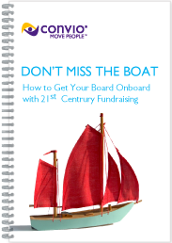
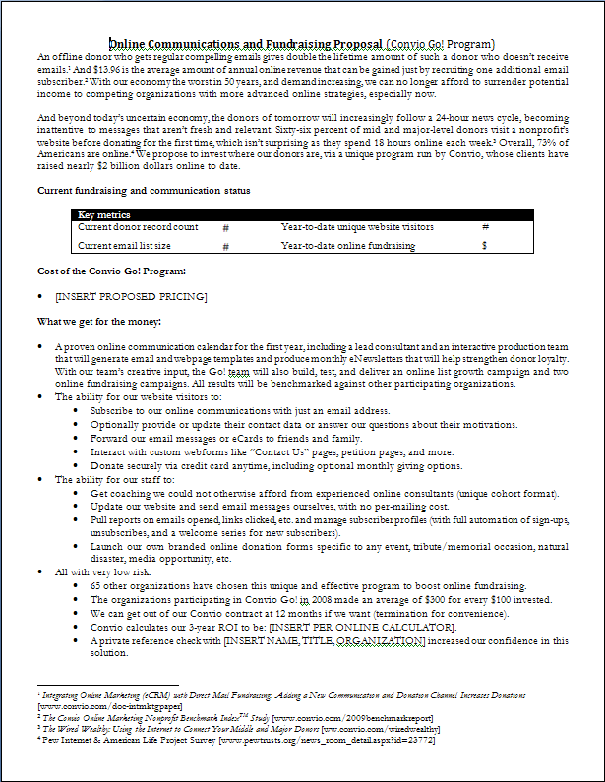
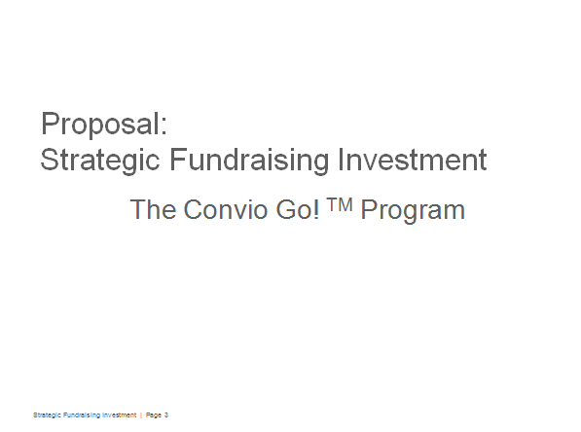
Grab a “Get Your Board Onboard” Toolkit
Tools to persuade your board that:
  The Internet is not a fad
  A website is not enough
  You’ve done your homework
  You have a plan…and you
  can prove it works!
1
2
3
Notes:
The Get Your Board Onboard guide is a .PDF document intended for nonprofit leaders and staff to inform internal discussions and guide you in gathering and summarizing “state of the organization” metrics related to current online activities and results. It includes demographic and industry trends as well as key components of online initiatives and mini case studies.
The Online Communications and Fundraising Proposal memo is a MS Word document intended for board members. You can cut/paste the information into your org stationery or simply email it to the board. But it’s also recommended you print copies to hand out at the board meeting in case not everyone has read their pre-meeting documents.
The Strategic Fundraising Investment Proposal deck is a PowerPoint document intended for the ED or other nonprofit leader to present to board members. Again, you can put it into your own org-branded template and make any modifications you’d like

Slide 46
Convio Online Fundraising Software
A Proven Action Plan (inc. Production)
Capacity-Building Consulting
+
+
=
Tangible Results Today & Know-How For Tomorrow
Notes:
You do NOT have to
Conduct research, follow trends, build consensus, cobble together tools, struggle to learn tools, neglect strategy, neglect supporters, get burned-out!

Slide 47
Thanks for Watching!
Questions? Email Danielle Springer: dspringer@convio.com
Or visit www.convio.com/go
Or call 1-888-528-9501

